Slide 1


VIVEKANANDA INSTITUTE OF TECHNOLOGY & SCIENCE
A MINI PROJECT REVIEW ON
AUTOMATED DECISION MAKING IN AIRPORT CHECKPOINTS BIAS DETECTION TOWARD SMARTER SECURITY AND FAIRNESS
Submitted by
MD.KHALID, H.T.NO: 21N61A0546
P.MANIDEEP, H.T.NO:21N61A0515
KHAJA KAIFUDDIN, H.T.NO:21N61A0539
MD.ZAHEER UDDIN, H.T.NO:21N61A0550
Under the Guidance of
APOORVA, Assistant Professor

Slide 2
1
ABSTRACT
Automated decision making emerges as the enabler for risk-based and smarter security. However, ethics, privacy, and the General Data Protection Regulation (GDPR) provide a very challenging setting along with monitoring fairness and bias detection when applying artificial intelligence (AI) security solutions
GROUP 11, VITS
2

Slide 3
2
OVERVIEW
EXISTING SYSTEM
SYSTEM ARCHITECTURE
UML DIAGRAMS
HOW IT WORKS
SYSTEM REQUREMENTS
Sample output screenshot
PROBLEM
MODULES
CONCLUSION
PROPOSED SYSTEM
DATA FLOW DIAGRAM
Thank You
GROUP 11 ,VITS
3

Slide 4

3
EXISTING SYSTEM
The current system uses advanced technologies like profiling and automated processing to make airport security smarter and more efficient.
This means it collects and analyzes information from various sources to identify risks and ensure safety.
GROUP 11, VITS
4

Slide 5
4
HOW IT WORKS
1. Data Collection
The system gathers data from distributed sensors and other inputs, such as cameras and visitor behavior.
2. Decision-Making:
Algorithms process this data to detect suspicious activities or assess the trust level of visitors.
GROUP 11,VITS
3. Fairness Monitoring
It keeps an eye on how manual surveillance systems at airports and critical infrastructures are performing, ensuring they are fair and efficient.
5

Slide 6
5
PROBLEM
First Problem
Bias in Results: Sometimes, the system may give unfair results because of:
- Biased input data (e.g., faulty sensors or incomplete information).
- Flawed algorithms (e.g., assumptions that unfairly target certain groups).
GROUP 11 , VITS
Second Problem
Ethics and Privacy: There are concerns about how personal data is handled and whether the system respects privacy and follows regulations
6

Slide 7
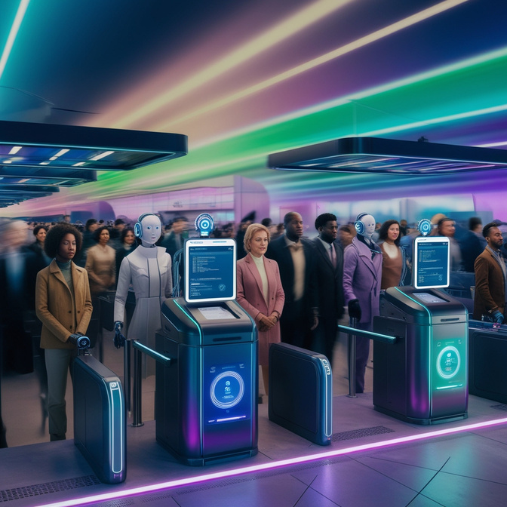
6
PROPOSED SYSTEM
TO ADDRESS THESE ISSUES, A BIAS DETECTION SYSTEM IS SUGGESTED.
1
It uses legal rules and
regulations as a reference.
GROUP 11, VITS
2
It compares these rules with the patterns (association rules) in the data to check if there’s any unfairness in the system’s decisions.
3
This ensures that airport security systems remain ethical, unbiased, and compliant with regulations.
7

Slide 8

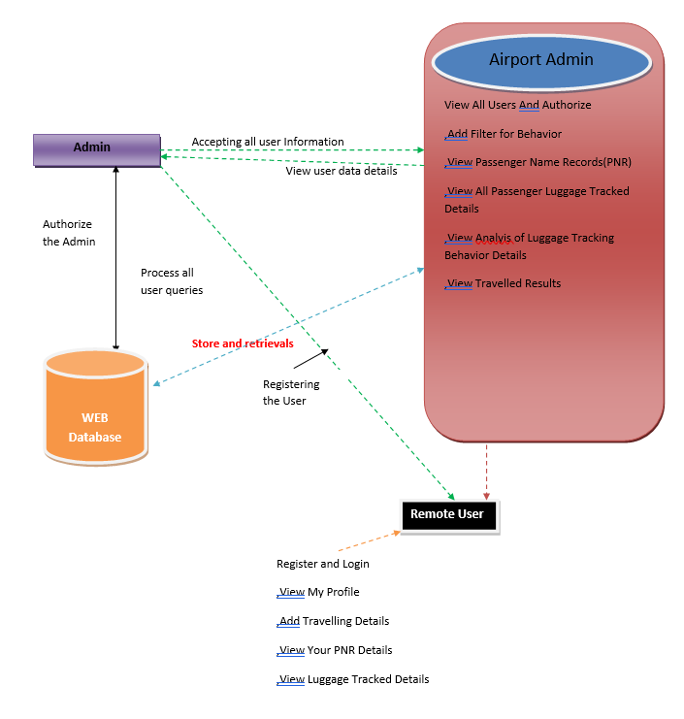
7
ARCHITECTURE DIAGRAM
8

Slide 9
8
SYSTEM REQUIREMENTS
H/W System Configuration:
Processor - Pentium –IV
RAM - 4 GB (min)
Hard Disk - 20 GB
Key Board - Standard Windows Keyboard
Mouse - Two or Three Button Mouse
Monitor - SVGA
9

Slide 10
9
SYSTEM REQUIREMENTS
Software Requirements:
Operating System - Windows XP
Coding Language - Java/J2EE(JSP,Servlet)
Front End - J2EE
Back End - MySQL
10

Slide 11
10
MODULES
Airport Admin
USER
In this module, airport admin has to login with valid username and password. After login successful he can do some operations such as View All Users And Authorize,Add Filter for Behavior ,View Passenger Name Records(PNR) ,View All Passenger Luggage Tracked Details ,View Analyis of Luggage Tracking Behavior Details ,View Travelled Results
In this module, there are n numbers of users are present. User should register before doing some. After registration successful he can login by using valid user name and password. Login successful he will do some operations such as View My Profile,Add Travelling Details,View Your PNR Details,View Luggage Tracked Details
GROUP 11, VITS
11

Slide 12
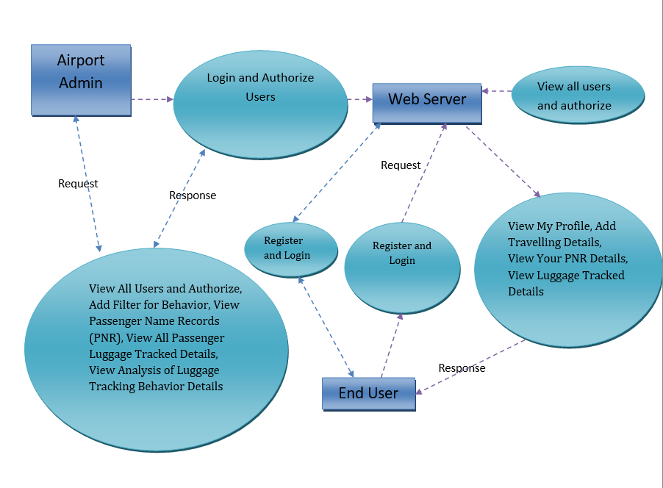
DATA FLOW DIAGRAM
11
12

Slide 13
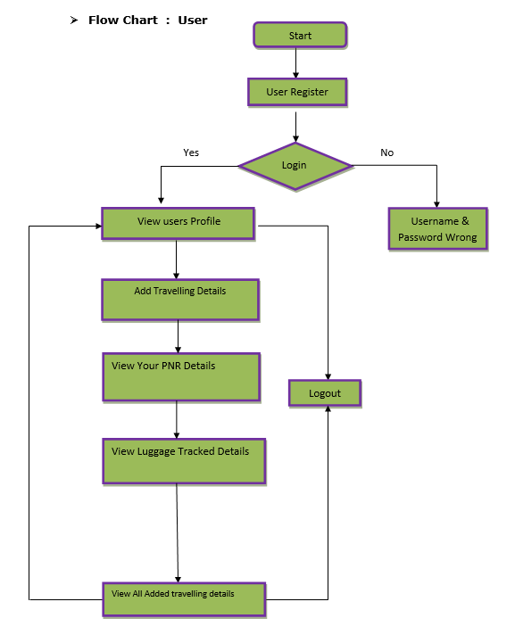
12
FLOW CHART
USER
13

Slide 14
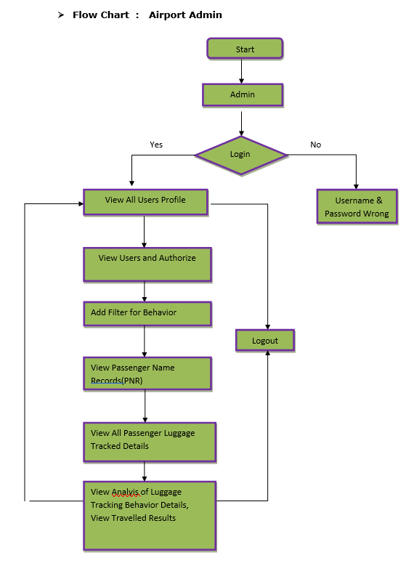
13
FLOW CHART
AIRPORT ADMIN
14

Slide 15
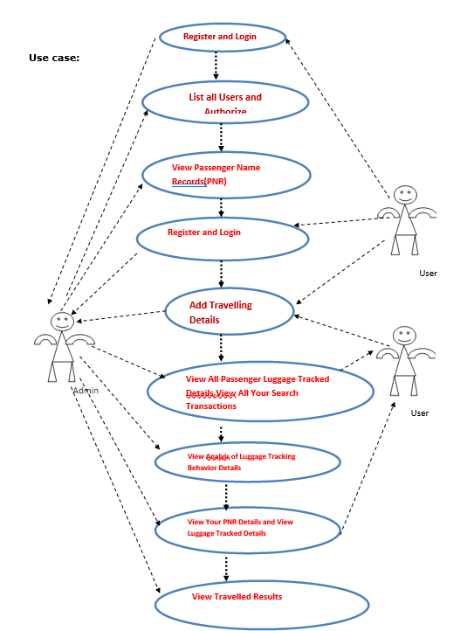
14
USE CASE
15

Slide 16
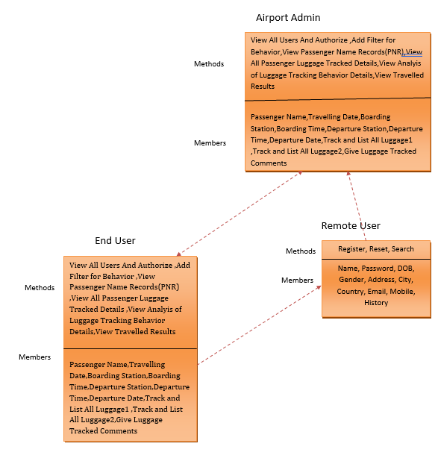
CLASS DIAGRAM
15
16

Slide 17
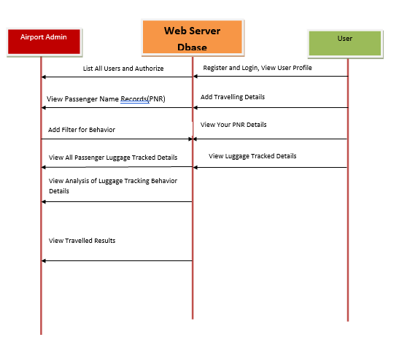
SEQUENCE DIAGRAM
16
17

Slide 18
SAMPLE OUTPUT SCREENSHOTS
18

Slide 19
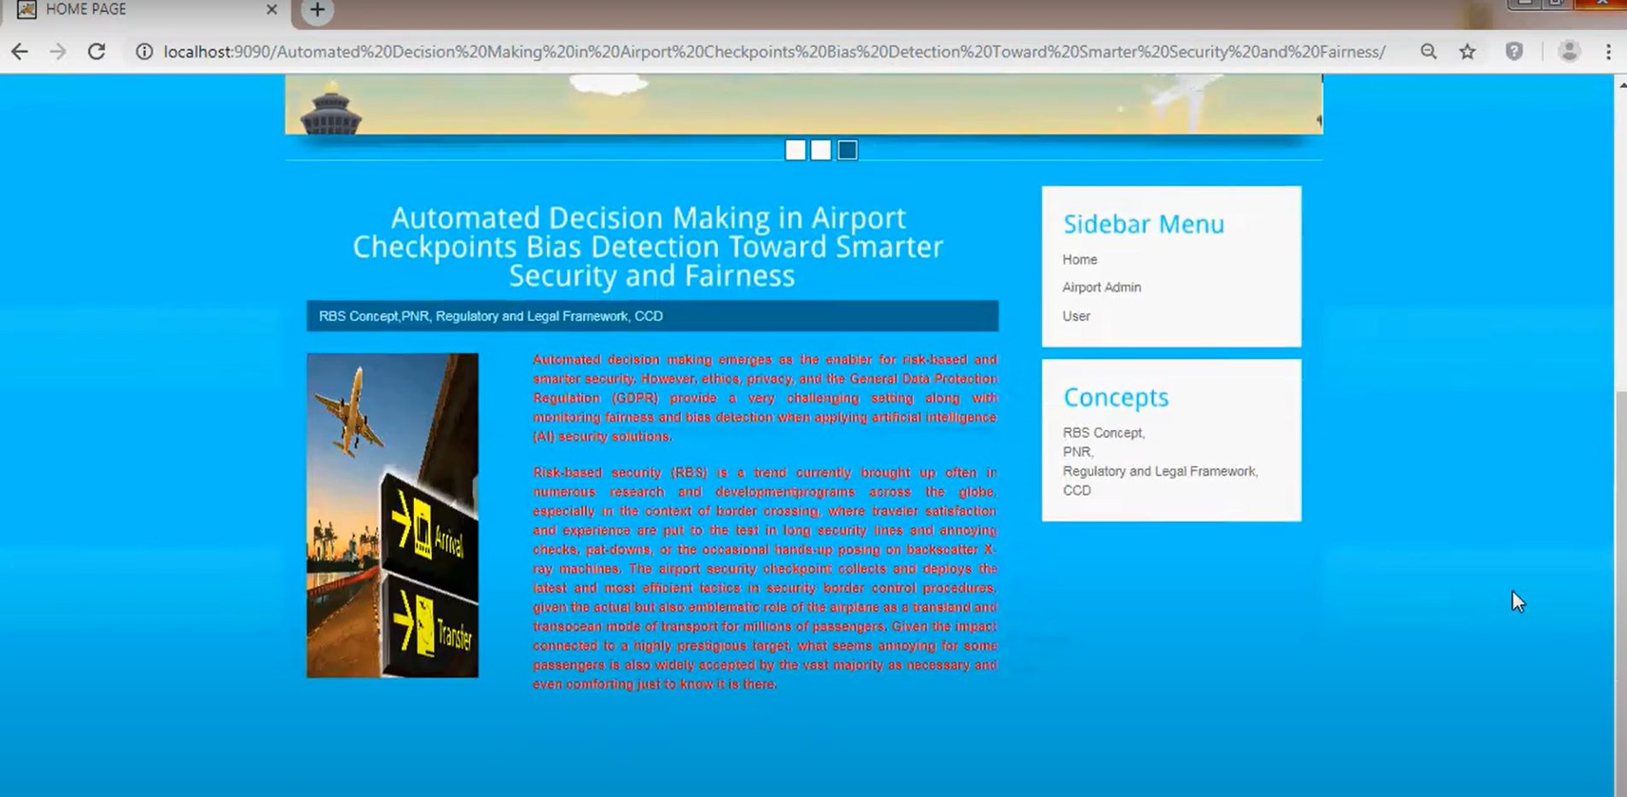
18
AUTOMETED CHECKPOINT
19
FIGURE 1.1 HOME PAGE

Slide 20
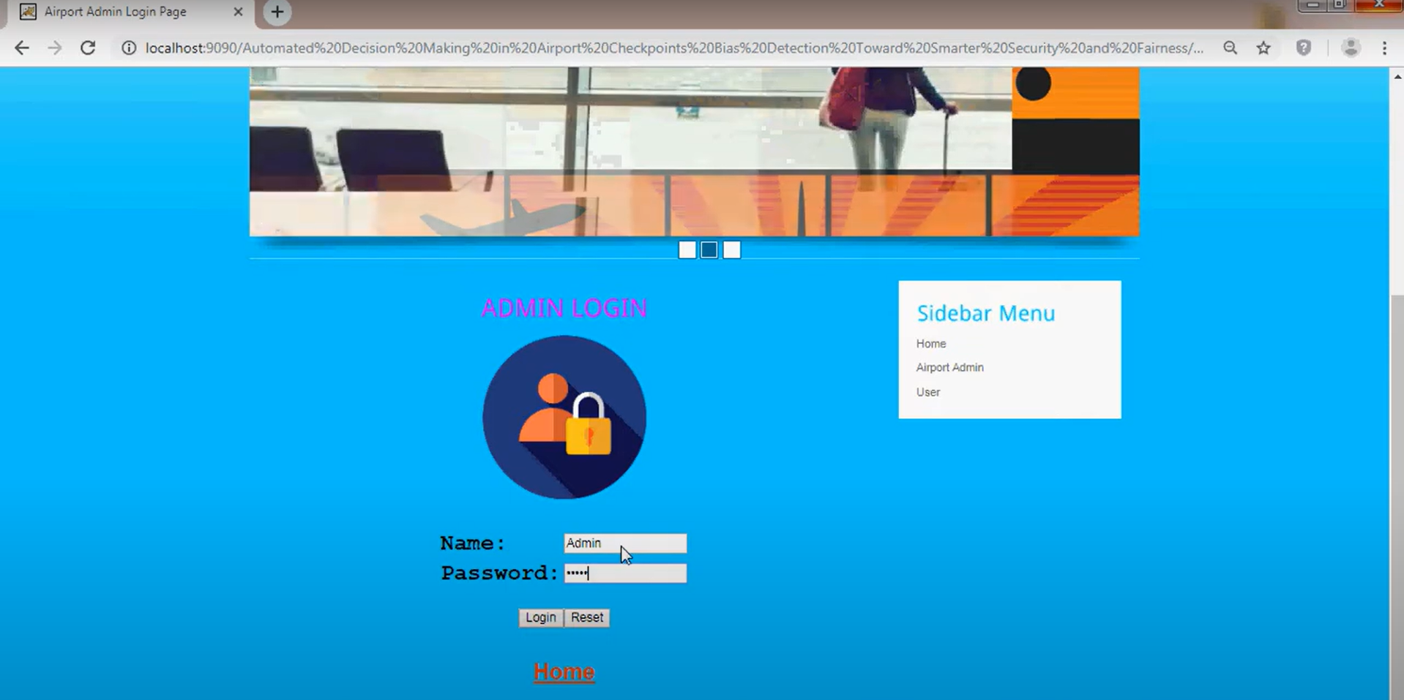
19
20
FIGURE 1.2 ADMIN LOGIN PAGE

Slide 21
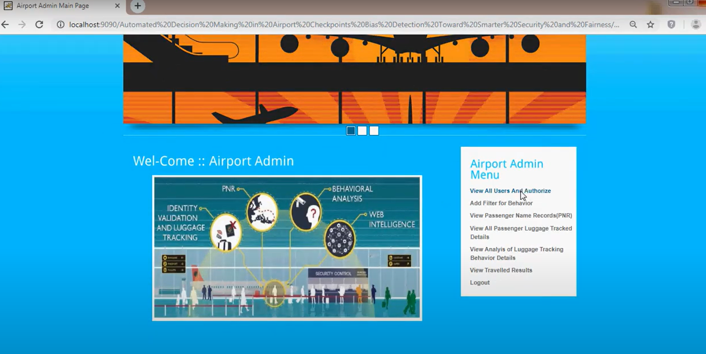
20
21
FIGURE 1.3 ADMIN PAGE

Slide 22
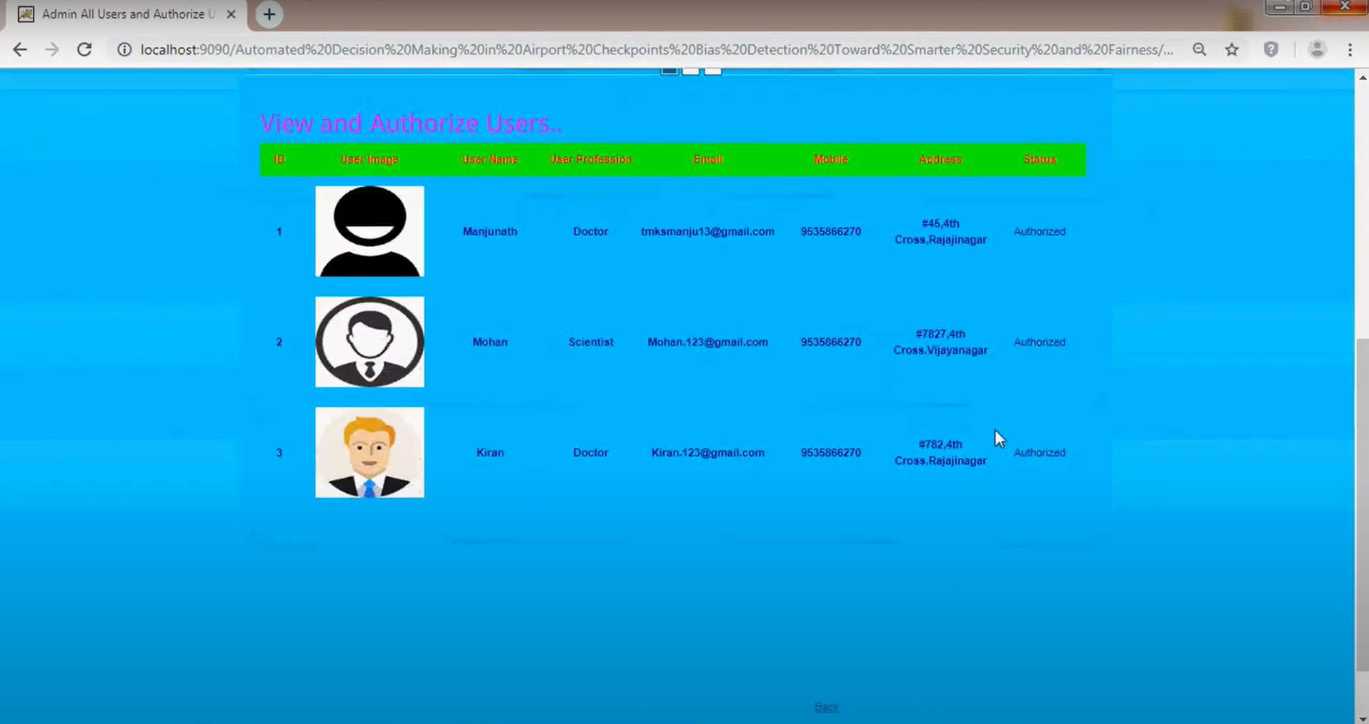
21
22
FIGURE 1.3 ADMIN PAGE

Slide 23
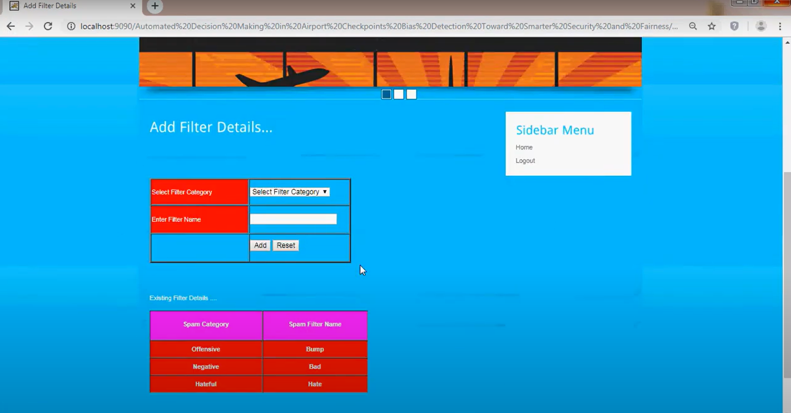
22
23
FIGURE 1.3 ADMIN PAGE

Slide 24
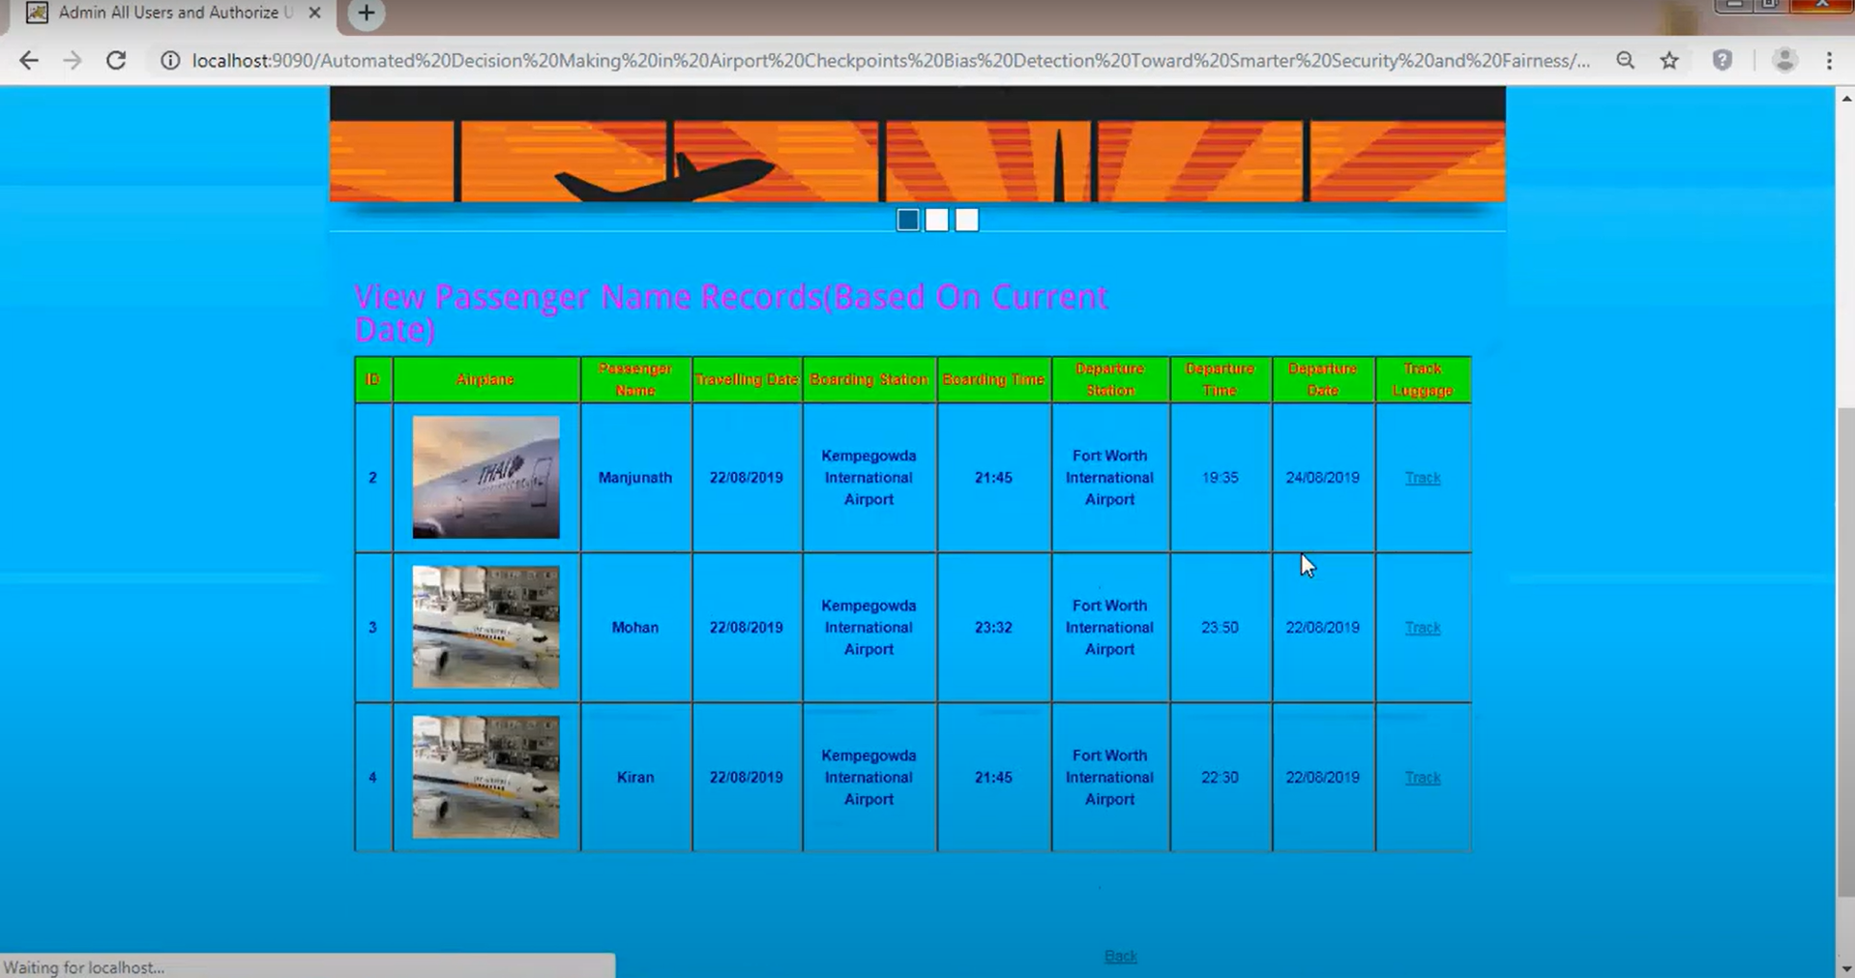
23
24
FIGURE 1.3 ADMIN PAGE

Slide 25
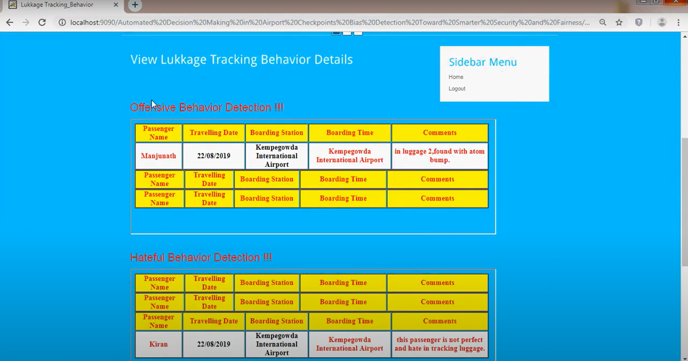
24
25
FIGURE 1.3 ADMIN PAGE

Slide 26
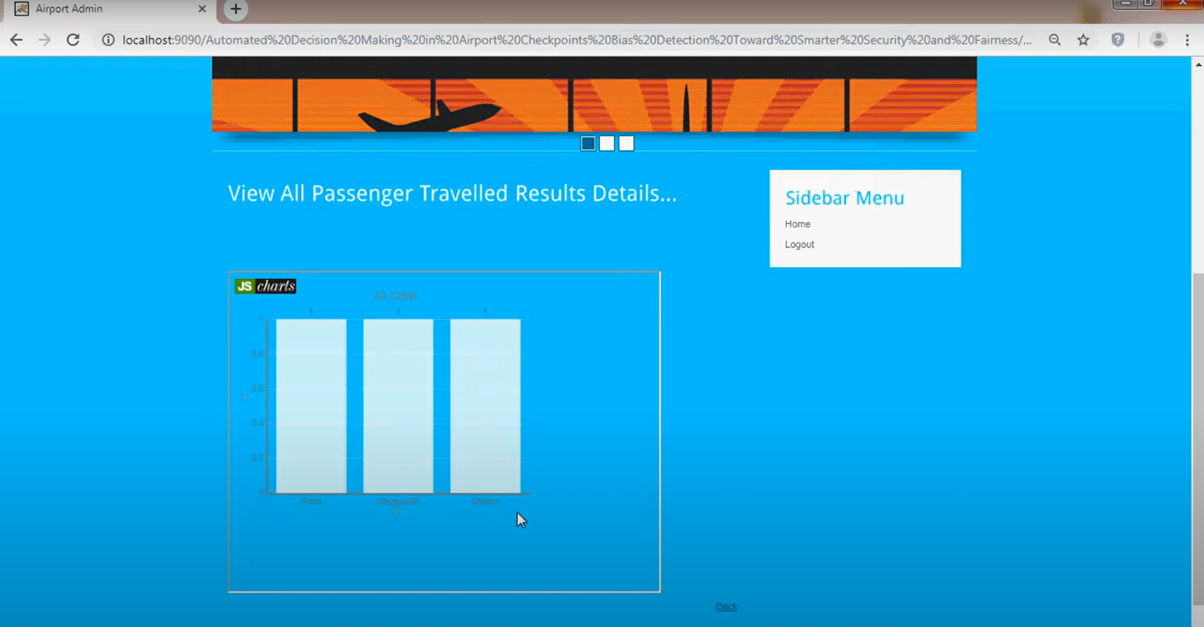
25
26
FIGURE 1.3 ADMIN PAGE

Slide 27
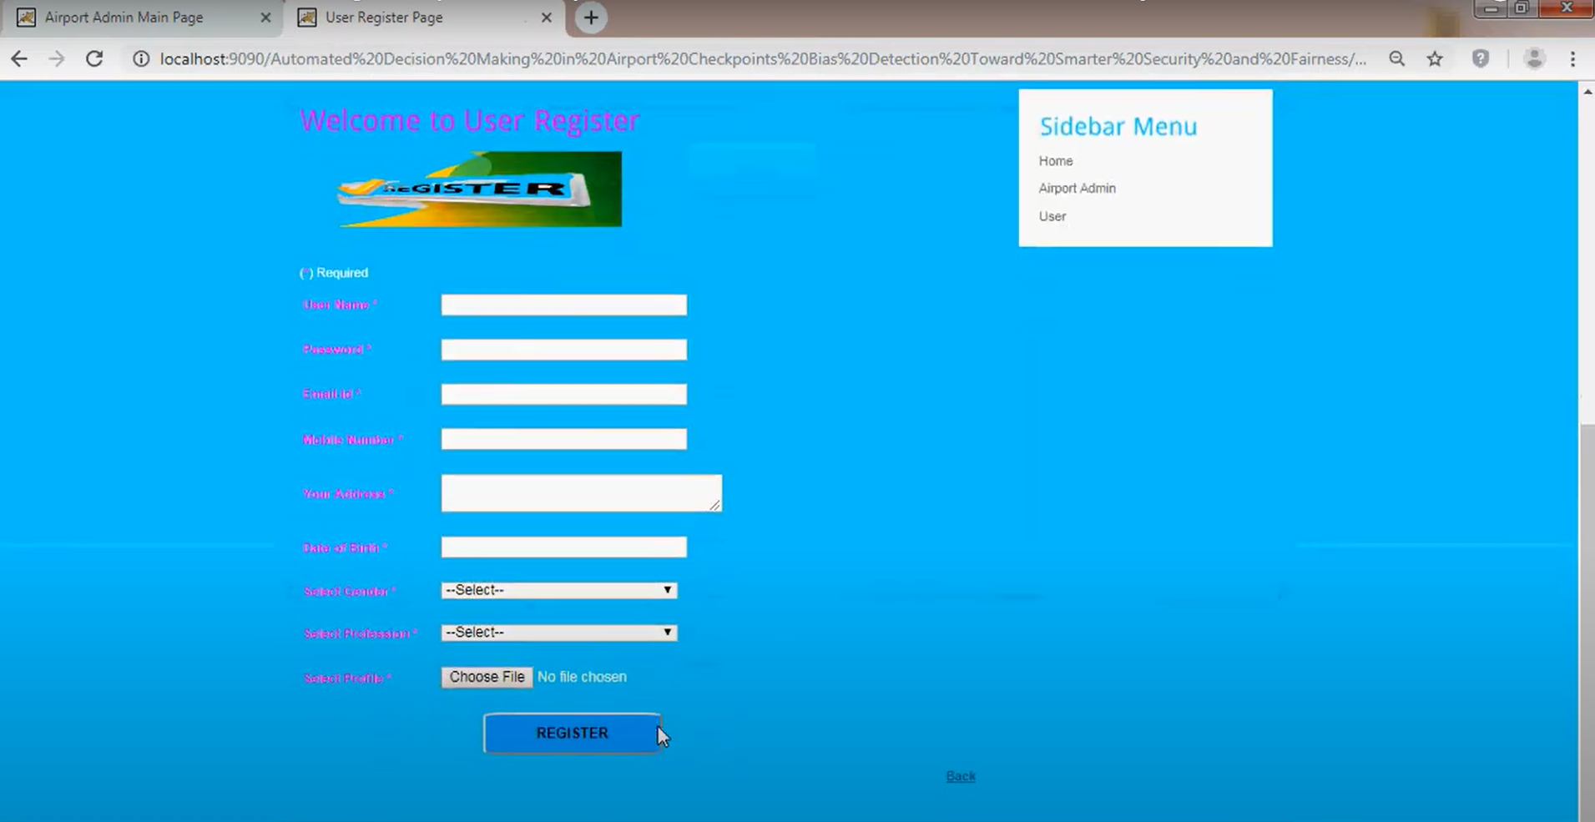
26
27
FIGURE 1.4 AREGISTER PAGE

Slide 28
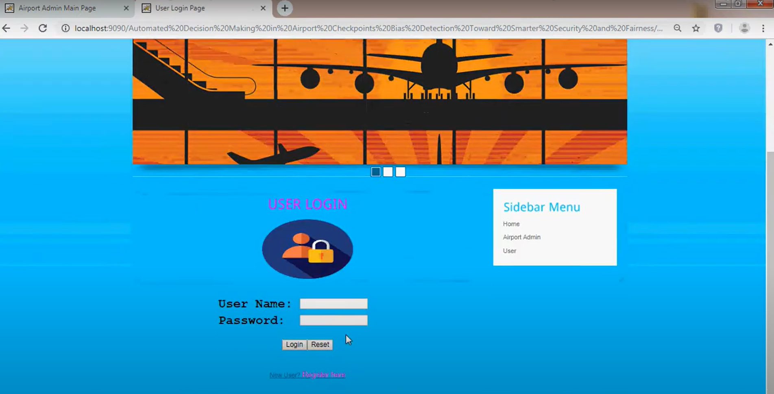
27
28
FIGURE 1.5 USER LOGIN PAGE

Slide 29
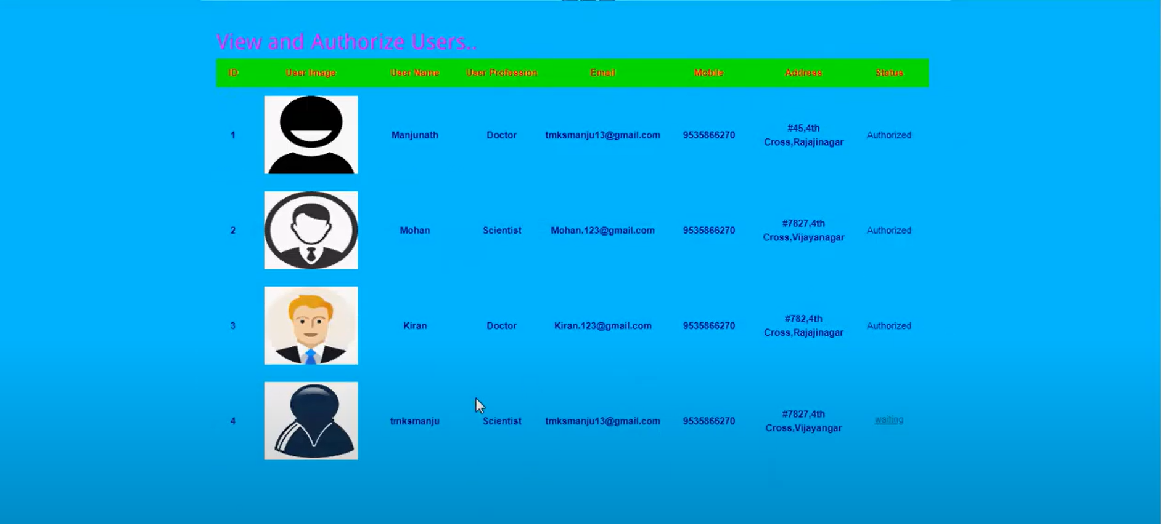
28
29
FIGURE 1.5 USER PAGE

Slide 30
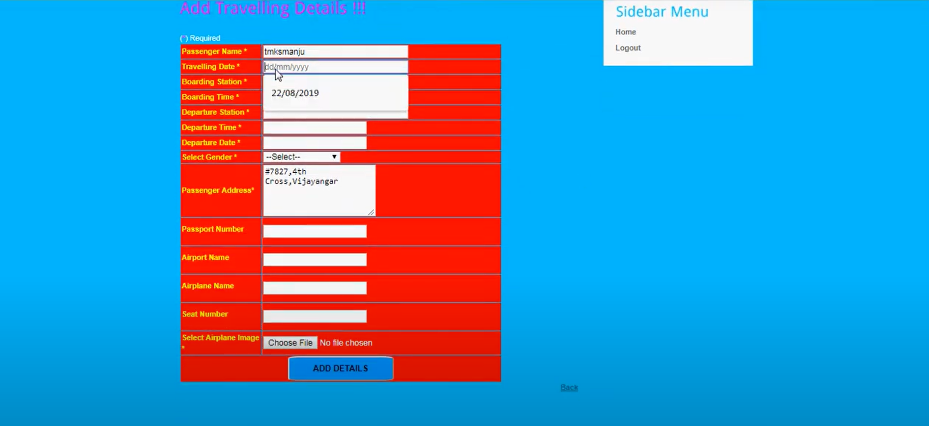
29
30
FIGURE 1.5 USER PAGE

Slide 31
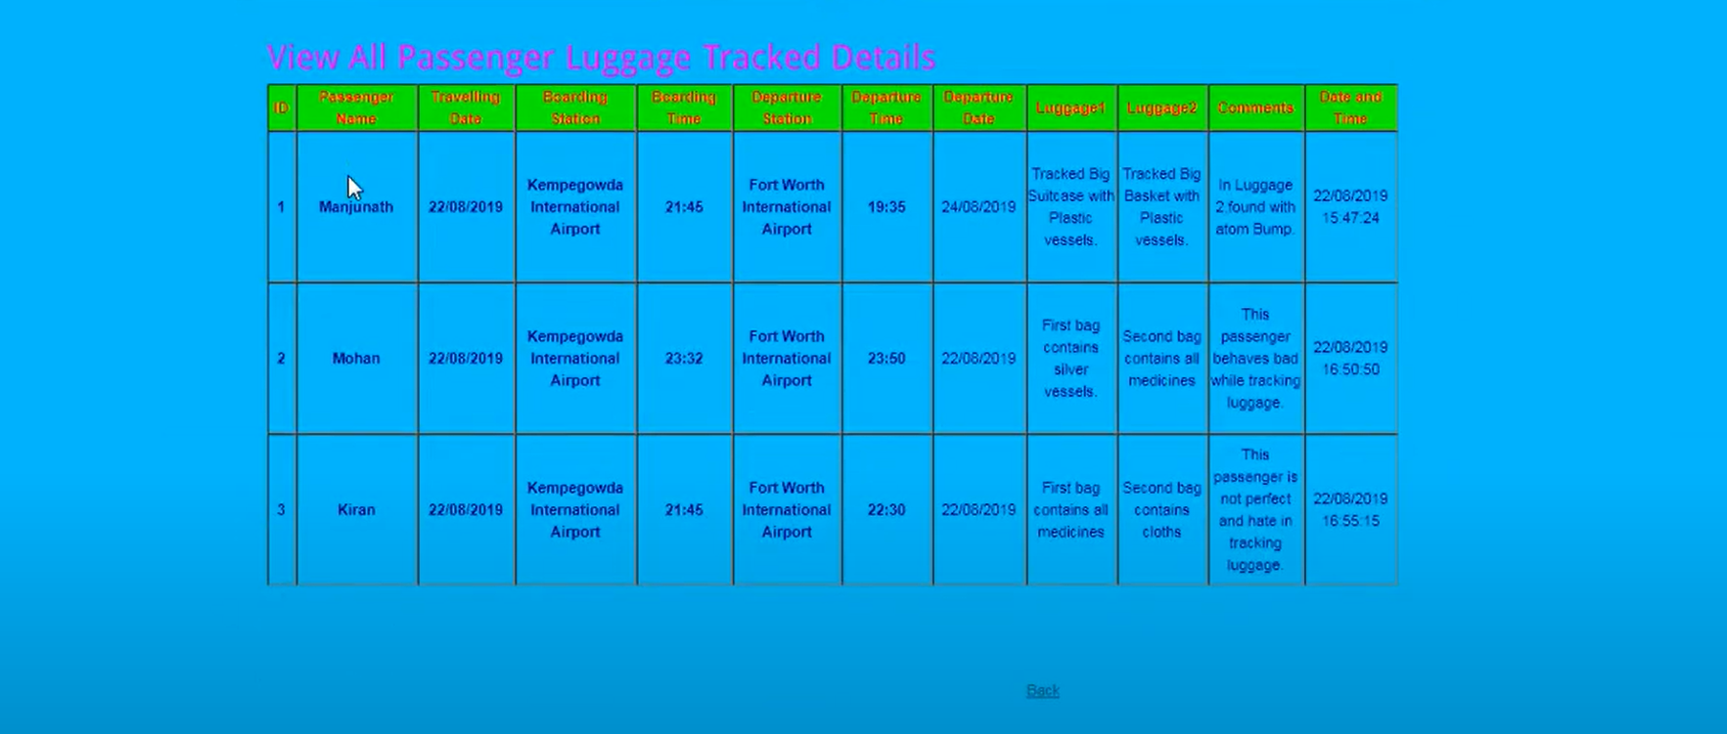
30
31
FIGURE 1.5 USER PAGE

Slide 32
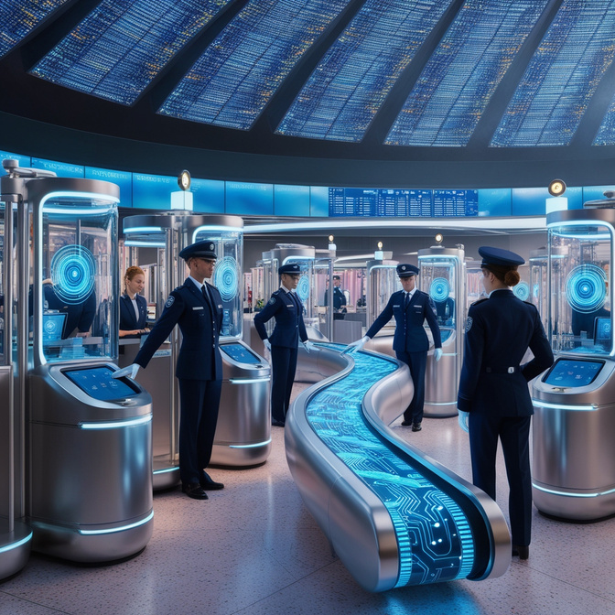
31
CONCLUSION
1. AI security systems face challenges with fairness, privacy, and legal compliance due to biases in design and data.
2. Our solution integrates legal regulations into bias detection to ensure compliance and fairness.
3. We refine input data to align with legal standards while maintaining accuracy.
4. Simulation models enrich training data with realistic behavior to ensure unbiased threat detection.
GROUP 11 , VITS
32

Slide 33
THANK YOU
33

